Slide 1
Important information for facilitator- see notes
Please read the Facilitator’s Guide in the notes for this slide before you hold the training. Please also read the notes for each slide as preparation, as these guide you as the Facilitator through the training – thank you
Notes:
Facilitator’s Guide
Important information FOR YOU – the training facilitator
First and foremost – Thank you! Thanks for your willingness to be a key part of the church’s ministry and witness – ensuring we do all within our power to keep children and vulnerable adults safe in God’s church. We know that you are a busy person, so we are providing this resource to assist you in the task. Your role is key.
This training is for volunteers in services and activities connected with congregations – and specifically, Op-Shops. Your role is to set up the event, lead the group through the slides and workbook, and give feedback to us in Culture of Safety afterwards.
A word about the structure of the training
Because we do not expect facilitators to be trained in trauma and abuse counselling, the training has specifically been designed not to encourage disclosure and not to traumatise the group by sharing stories of abuse.
For this reason, it is important to pre-read the information in the notes to the slides, so you are familiar with its content. You are not required to read every word to the group and should treat the information as guidance.
Who should attend this training?
This resource was developed specifically for volunteers in services and activities connected with congregations, such as Op-Shops.
Something to watch out for – your own self care
Please remember that working on this subject sometimes is upsetting or triggers memories of long-ago abuse. For some of the participants this session may arouse painful memories. This could apply particularly to the sections on types of abuse and the effects of abuse. While the training session itself is not intended to offer pastoral care, there may be a need for follow up pastoral care and possible referral to a specialist counsellor. The Culture of Safety Unit is able to arrange this.
If questions or comments relate to a criminal matter, ring the police. Ring the Culture of Safety unit Phone: (03) 9116 1400 Email: contactcultureofsafety@victas.uca.org.au and leave a message – to follow up
Additional support for you as the facilitator can be accessed by contacting the Bethel Pastoral Centre, (03) 9859 8700 or email bethel@victas.uca.org.au
This material raises complex questions and issues. Every situation where abuse has occurred varies.
• If people interrupt too often or want to deal with issues peculiar to one particular context, and of little interest to others, you may ask them to talk with you after the session or contact the Culture of Safety Unit.
• If people raise complex questions to which you do not know the answer, or for which there is not time, please ask them to contact the Culture of Safety Unit.
You may always to refer issues to the Culture of Safety Unit
Our contact details are:
Phone: (03) 9116 1400
Email: contactcultureofsafety@victas.uca.org.au
And lastly, please ensure every participant has completed the attendance sheet. Then the facilitator – you - register the training attendance at Group Training Registration. Once we have received and processed it, we will issue Certificates of Completion to the main email on the attendance sheet for distribution.
We will also update the central training register.
Thank you for serving our Church by facilitating this training.

Slide 2

Uniting Church in Australia
Child Safe Training
Op Shop Volunteers
Notes:
Page 3 of Booklet
Welcome participants to the training session. Make sure everyone knows where the toilets and break facilities are located. Facilitate introductions. Hand out participant workbooks.
Invite people to follow along in their workbooks as they follow the slides.
Page 3 of the Booklet
Introduction to Child Safe Training
Thank you for taking this time to raise your awareness of how we can be a child safe Synod together. As a community, every one of us has a role in creating our shared culture. Child safety is a key part of being safe and welcoming for children, young people, families and other vulnerable people.
We show we care not just in our words but also in our actions as a whole community.
What we believe
The Uniting Church is Australia believes that all people, including children, are made in the image of God. As a Christian community we believe that God reaches out to us in love and acceptance, and that our relationships with each other should express love, care and respect.
(Safe Place Position Statement developed by the UCA Commission on Women and Men in 1997)
Central to living out the gospel is to love God and to love others. As a community of faith, we are committed to provide safe environments for all people including children, so that they may live life in all its fullness.
We also acknowledge the rights of children as detailed in the Convention on the Rights of the Child (United Nations, 1990, Article 49) that States shall protect children from physical or mental harm and neglect, including sexual abuse and exploitation.

Slide 3

Your safety when engaging with Child Safe Training
This training includes some content regarding child sexual abuse.
If you feel you would like support at any time including before or after the training, please reach out.
Support may include calling:
Lifeline - 13 11 14 Lifeline is a national charity providing 24 hour crisis support services.
Blue Knot Foundation - 1300 657 380 (9am-5pm AEST) Blue Knot Foundation provides support for people who have experienced childhood trauma.
Notes:
Page 3 of the Booklet
Talk to participants about their feelings about the issues raised and make sure they seen the details of support services to contact at any time as on this slide and in the booklet. Inform participants they are free to pause or leave if the material makes them uncomfortable, and only return when they feel ready to do so.
If people feel affected by the training, after they have left, they should contact the support services listed in the training. If they need further guidance on other support services they are welcome to contact the Culture of Safety Unit.

Slide 4
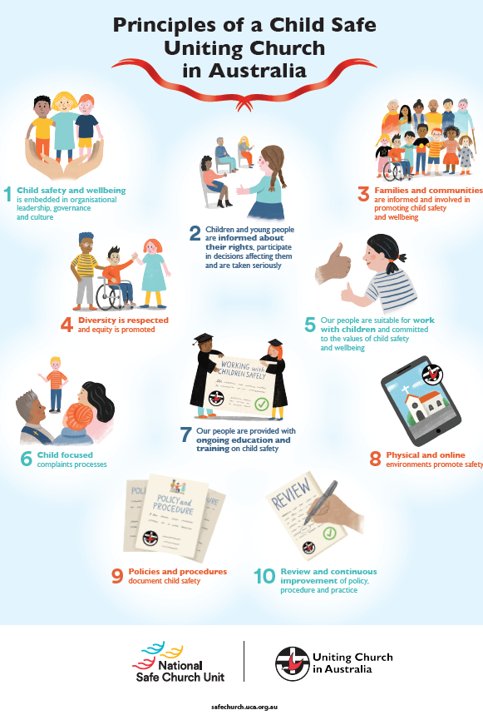
Child Safety is everyone’s business!
Notes:
Page 4 of the booklet
Remind the participants that as part of the broader Uniting Church community, volunteers together share the commitment to protecting children from harm and abuse. Thank them for being part of a caring community alongside us.

Slide 5
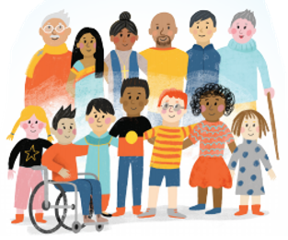
Cultural considerations
Issues about child safety may need to be discussed in different ways in different cultural contexts.
However, there is no room for variations in the requirement that everyone across the life of the Church must support the Church's commitment to being a safe place for children and young people.
Notes:
Page 4 of booklet
Issues about child safety may need to be discussed in different ways in different cultural contexts.
The Church is keen to ensure the Child Safe Training is culturally respectful and relevant. However, there is no room for variations in the requirement that everyone across the life of the Church must support the Church's commitment to being a safe place for children and young people.
If you wish, you may encourage participants to discuss different cultural contexts in which child safety might be viewed. Emphasize that child safety is paramount whatever the cultural context.

Slide 6

How is this information relevant for volunteers?
All people, especially children and young people, who are involved in any of the Uniting Church’s activities, services, events or programs have a right to feel and be safe.
Volunteers help us provide safe environments where children and young people are cared for, respected, nurtured and sustained.
Notes:
Page 4 of the booklet
While a person may see what they do as ‘just a role’ or ‘just doing my bit to contribute’, the selection of a volunteer to take on a role is an important responsibility.
This person can be seen to represent “the Church” and so we must be especially mindful of our responsibilities in regard to the safety of children and always do the right thing.

Slide 7
Principles of a Child Safe UCA
We are called to be a safe church and all children have the right to participate safely in the life of the Church.
This commitment extends to services and activities connected to our congregations, such as Op-Shops
Notes:
Page 4 and 5 of the booklet
Together we uphold these principles in all we do together in our volunteer roles. Being aware of these principles and knowing what we need to do to uphold them in our volunteer work for the Church is a key part of this training.

Slide 8

Transparency and accountability are the focus of the Code of Conduct
Our leaders and volunteers are expected to behave in ways that are a positive influence in our communities.
Notes:
Pages 5-7 of the booklet
The Code of Conduct is an essential part of being a volunteer with us. It helps us to be clear for ourselves and our community about the required standards of behaviour as we serve.

Slide 9

Code of Conduct for Lay Leaders and Volunteers and the Code of Ethics and Ministry Practice
As a volunteer you are required to adhere to the Child Safe Code of Conduct in your booklet.
Take the time now to read through it.
Notes:
Page 5 - 7 of the booklet
Please take the time to allow participants to quietly read through the Code of Conduct for themselves. If anyone has any questions about the Code that go beyond the application of the Code within the Op-Shop or volunteer activity setting, please refer them to the Culture of Safety Unit.

Slide 10

Duty of Care
Duty of care applies to:
planning,
running activities and services,
and communication
to prevent and manage risks to:
physical, emotional, and spiritual
environments.
Notes:
Page 7 of the booklet
Duty of care applies to planning, running activities and communication to prevent and manage risks to physical, emotional, and spiritual environments.
Fulfilling our duty of care is a key part of serving in a congregational activity such as an Op Shop.
If you are not sure what to do in any given task or situation – ask! Always seek help and guidance when you are not clear on what you are doing. It is better to ask and clarify than make a mistake and cause harm or problems. We want you to feel supported in what you are doing in your volunteer role.

Slide 11

The Uniting Church complies with child safety legislation in Victoria and Tasmania
As a volunteer you must:
Have a valid Working With Children Check or Registration to Work with Vulnerable People
Raise any child safety concerns to the co-Ordinator
Report child abuse or concerns related to child harm or abuse
Notes:
Page 7 – 8 of booklet
We must always follow the law in our protection of children – this section of the training is important so that volunteers are aware and always ensure they keep their Working With Children Check up to date.

Slide 12
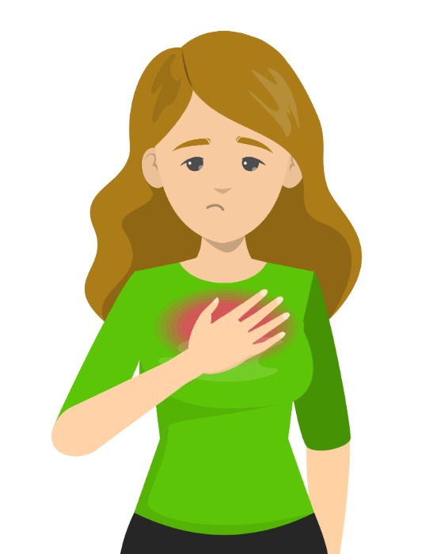
This next section of the training includes topics which can be challenging and confronting.
Please be aware of your own responses – you may feel some topics are unsettling or distressing.
Be safe and seek support when you need it.
Lifeline - 13 11 14
Blue Knot - 1300 657 380
Notes:
Page 8 of the booklet
Some of the material in this Section is confronting. Remind participants of the support available.
This unit includes topics which can be challenging and confronting.
Please be aware of your own responses – you may feel some topics are unsettling or distressing.
Be safe and seek support when you need it.
You can access support from services listed here.

Slide 13
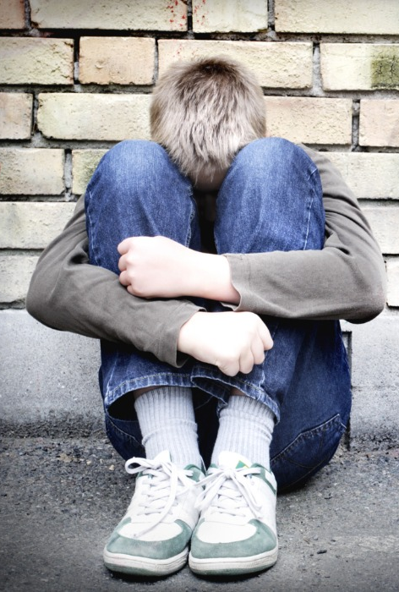
What is Child Abuse?
The World Health Organization defines child abuse and neglect as:
“All forms of physical and/or emotional ill-treatment, sexual abuse, neglect or negligent treatment or commercial or other exploitation, resulting in actual or potential harm to the child’s health, survival, development or dignity in the context of a relationship of responsibility, trust or power.”
Notes:
Page 8 of the booklet
Read this definition aloud so everyone is clear on this.

Slide 14

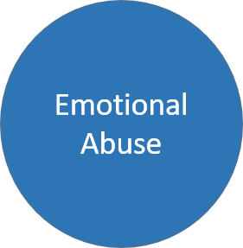



Child abuse can be generally defined in 5 main types:
  Physical Abuse
  Sexual Abuse
  Exposure to Family Violence
  Neglect
  Emotional Abuse
Notes:
Page 9 -11 of the booklet
It’s important to note that our own perceptions can impact on whether we see something as abuse. This will be influenced by our own life experiences, our community and culture.
Our understanding of child abuse covers:
Physical Abuse
Sexual Abuse
Exposure to Family Violence
Neglect
Emotional Abuse
We will look at each of these in turn.

Slide 15

Physical Abuse
Behaviours of physical abuse might include:
● threatening to harm or kill
● kicking, punching, hitting (including using objects) and the frequency and force used was significant enough that an injury was likely
● shaking (particularly of young babies)
● burning, biting, pulling out hair
● alcohol or other drug administration or misuse (prescribed and illicit drugs)
● fabricated or induced illness
● Exposure to extreme temperatures for sufficient duration to cause serious harm.
Notes:
Page 9 of the booklet
The child has suffered or is at significant risk of suffering serious physical trauma or inflicted injury due to the actions of their caregiver.
An injury is considered ‘inflicted’ if it was alleged to be caused wilfully or as a result of punishment.

Slide 16

Sexual Abuse
Behaviours of sexual abuse might include:
● Exposing a child to pornographic material or using them in the production of child sexual abuse material
● fondling, kissing or holding a child in a sexual manner
● talking in a sexually explicit way that is not age or developmentally appropriate
● making obscene calls, text messages or emails to a child or young person.
Notes:
Page 9 of the booklet
Sexual abuse is any sexual activity or behaviour that is imposed on a child or young person by someone else. Sexual abuse occurs when someone in a position of power uses that power to involve the child or young person in sexual activity.
The long-term impact of that trust being broken is too high a cost.

Slide 17

Exposure to Family Violence
Behaviours related to exposure to family violence might include:
● killing or attempting to kill a household member
● use of a weapon or displaying a weapon in a threatening manner
● seriously threatening to harm a child or young person, other adult or self (including threats to kidnap and hold hostage)
● psychologically impacted or physically harmed during the incident.
● sexual assault, fractures, internal injuries, disfigurement, burns, death and/or any injury that may require hospitalisation.
Notes:
Page 10 of the booklet

Slide 18
Neglect
Behaviours of neglect toward a child or young person include:
Physical neglect
them having no safe place to stay, or current sleeping arrangements pose serious danger or risk
hygiene significantly compromised to the extent that physical health is compromised or at risk of being compromised
food/ fluids – withholding as punishment, is inappropriate, or insufficient.
Medical neglect
medical illnesses, disability, injury or mental health condition being left unattended/unaddressed or treated contrary to medical guidance/ treatment.
Supervisory neglect
child or young person is left alone for an inappropriate length of time, or the quality of interaction is not sufficient for their safety.
Notes:
Page 10 of the booklet
Neglect is characterised by serious, ongoing failure to provide for a child's basic needs, to the extent that the child is not receiving the care and supervision necessary to protect them from harm, has suffered serious physical injury or illness, or there is risk of serious harm to the child’s wellbeing and development.
Neglect can be unintentional rather than a deliberate act.

Slide 19
Emotional Abuse
Behaviours of emotional abuse toward a child or young person include:
violence
terrorising
parental alienation
exploiting or corrupting behaviour
parent or carer isolates the child or young person or denies emotional responsiveness
hostility
rejection or withdrawal of love
degrading the child’s worth
Notes:
Page 11 of the booklet
The child’s social, emotional, or cognitive development is impaired or seriously at risk as a direct result of persistent caregiver behaviour or attitude towards the child, whereby the child’s self-esteem and social competence are undermined or eroded over time.
Emotional abuse is defined as abuse that occurs when a person is subjected to behaviours or actions (often repeatedly) aimed at preventing or controlling their behaviour, with the intent to cause them emotional harm or fear through manipulation, isolation or intimidation.
Degrading the child’s worth, including frequent verbal putdowns, negative prediction (e.g. 'you'll never amount to anything') and negative comparison (e.g. 'Why can't you be more like your sister?').

Slide 20
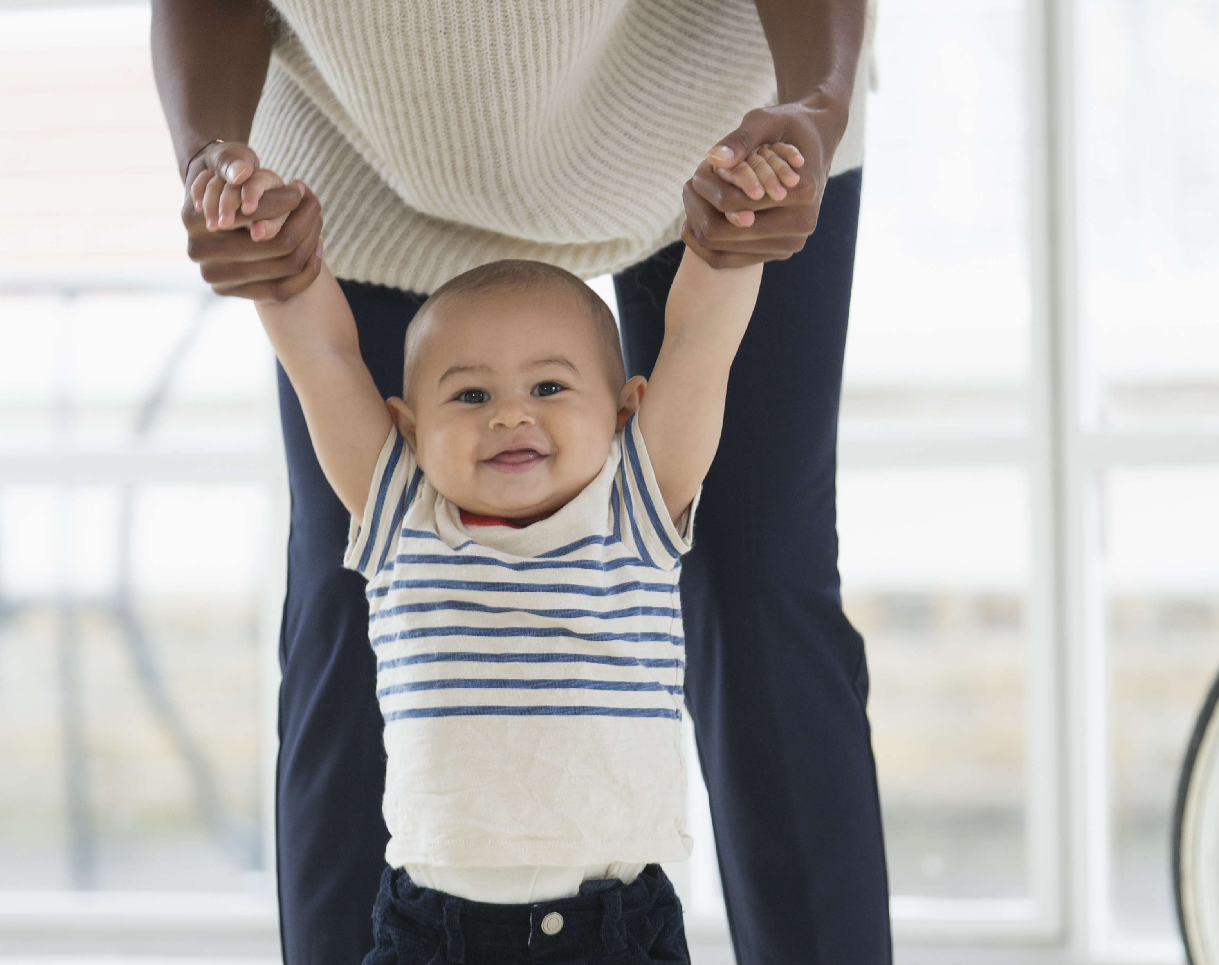
We can all take a role in child safety by being aware of what behaviour constitutes child abuse, and the indicators that a child is at risk of harm or being harmed.
Notes:
Page 11 of the booklet
We all work together as a community to protect the children.

Slide 21
Grooming Behaviours
Behaviours of emotional abuse toward a child or young person include:
● Making a child/young person feel special through gifts and treats
● Increased touching such as tickling, wrestling, sitting the child on their knee
● Spending time alone with a child/young person
● Talking about sex and sexuality with a child/young person
Notes:
Page 11 -12 of the booklet
What is grooming (also known as child sexual grooming)?
Grooming is a term used when a person tries to build a trusting relationship with a child or a child’s family so that they can sexually abuse the child.
These behaviours escalate over time and include more secrecy until a young person is trapped into silence and continues to be subjected to the abuse.

Slide 22
What should I do if I suspect grooming?
Share your concerns with your ministry agent or Safe Church Contact Person or the Synod’s Culture of Safety unit.
Notes:
Page 12 of the booklet
While most people have normal interactions with children, we need to be aware of the possibility of grooming.
If an adult feels a sense of unease or concern about a person’s interaction with a child/young person or their parent/carer, they should discuss this with a trusted person or the Synod Culture of Safety Unit.
If a child reports a concern about a person’s interaction with them, or with another child, it is important that adults listen and take the concerns seriously. Seek advice from a qualified person as to the necessary follow up response.

Slide 23
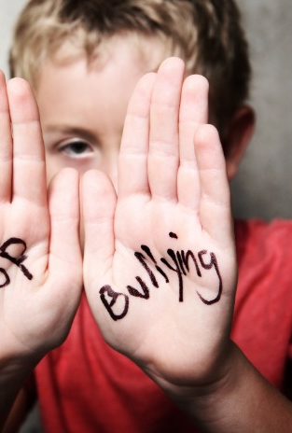
Preventing and responding to bullying behaviour
The first step to preventing something is to understand it -
Where does bullying occur? School yard, workplace, online, anywhere we have human relationships, including churches.
Notes:
Page 12 of the booklet
Bullying refers to any intentional and repeated behaviour which causes physical, emotional or social harm to a person who has, or is perceived to have, less power than the person who bullies.
Bullying is a complex issue and comes in many forms, occurs in various settings, and affects many population groups.
Bullying can impact victims, perpetrators, witnesses, and the community.

Slide 24
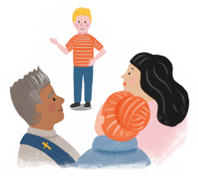
You are expected to raise your concerns
Notes:
Page 12 of the booklet
Silence, secrecy and inaction can shield concerning or abusive behaviour from sight.
Sometimes you may be unsure if you have a valid child safety concern, but someone’s behaviour or actions just don’t feel, look or sit right.
Knowing when and how to raise a concern and seek advice can ensure action is taken if inappropriate behaviour or abuse is suspected.
It is always adults’ responsibility to keep children and young people safe from harm.
Child abuse is never the fault of the child or young person. Most children and young people are abused by someone they know and that makes it hard for them to speak up.
If adults openly talk about feeling safe or unsafe, children and young people may feel they have permission to do so too.
Under Church policy and child safety legislation, reporting obligations apply where you have information that leads you to form a 'reasonable belief/suspicion' that another person has sexually offended against a child or if you believe there is a current risk of harm or abuse to a child or young person.
Victoria and Tasmania has 'failure to protect' and 'failure to report‘ legislation in relation to child abuse - these are criminal offences.
Where the report is of historic abuse, reporting obligations may still exist. Contact the Culture of Safety Unit for advice as needed.

Slide 25
It is always right to raise concerns and make a report -
Every disclosure, whether from a child, young person, or adult must be taken seriously, reported and handled with care for all involved.
Notes:
Page 12 -13 of the booklet
A disclosure is the sharing of facts or information by a person who has experienced harm or abuse, or by someone who observed the harm or abuse.
The disclosure may happen soon after the harm or abuse occurred, or many years later.

Slide 26

UCA expectations for reporting child safe concerns
● Proof is not needed.
● all adults have a moral and ethical obligation to report concerns about the safety of a child or young person, regardless of whether the applicable State or Territory legislation mandates a report.
Notes:
Page 12 -13 of the booklet
The laws of Victoria and Tasmania is clear that every adult in the Church has a role to play in keeping children and young people safe, including reporting any concerns.

Slide 27
THANK YOU!
Culture of Safety Contact Information
Phone: (03) 9116 1400
Email:
contactcultureofsafety@victas.uca.org.au
Notes:
Page 13 of the booklet
Thank you for attending.
If you have any questions, concerns or enquires please contact the Synod’s Culture of Safety Unit.
Before you leave, PLEASE ensure you have recorded your attendance – THIS IS ESSENTIAL – thank you!

